Slide 1





Team : Adventure
Project Title : Population vs Employment/Unemployment
(Australian Bureau of statistics)
Tony
Aroosa
Adeniyi
Nooshin
Mara

Slide 2





Overview of Project
Data is gathered from Australian Bureau of statistics(ABS)
Data cleaning & filtering has mainly been done in process of preparing csv’s in excel.
Biggest file size reduced from 99MB to several kbs.
Why & How
How has Australia’s employment rate changed over the years 2012-2018 for the population?
The correlation between different factors related to employment , unemployment
and underemployment.
Questions Addressed
Definition : As per ABS’ Employment = full- time + part-time jobs. Yearly change % take 2012 as our base year
Scope :Employment & unemployment & under employment overview, trends,
status, age/gender, state and territory)
Scope & Definition
We chose this topic because in December 2012, Australia Population had an increase of 1.8% on the previous year and was expected to continue to grow over the coming years as per Australia’s changing population research done by Joanne Simon-Davies, Statistics and Mapping (3).Based on this, we expect the
analysis to find a level of correlation between the variables selected for the period of 2012 – 2018.
Motivation & Summary

Slide 3


Slide 4
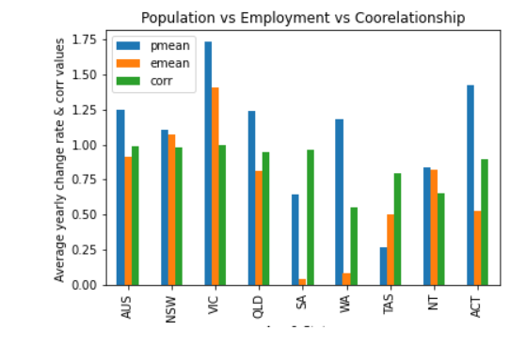

Slide 5
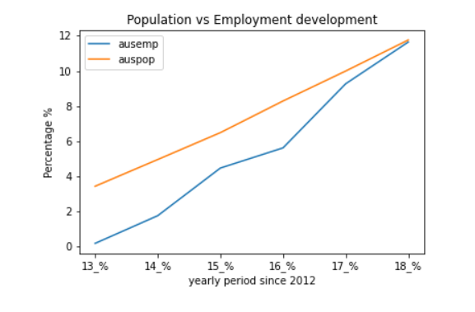
Charts have been prepared for each state, and saved in result folder, can be shown in any combination.

Slide 6


Slide 7

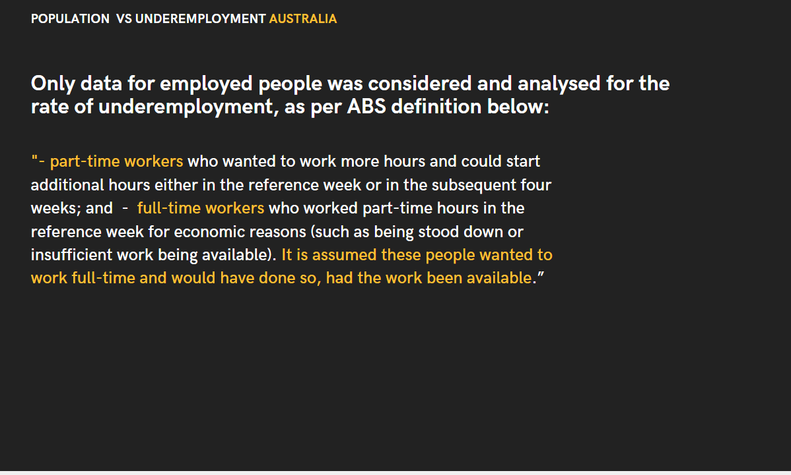

Slide 8
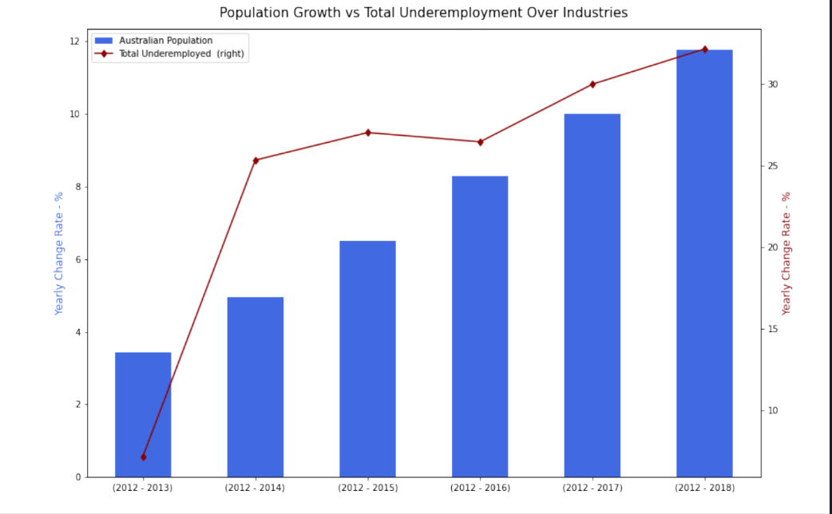
Population Growth vs Total Underemployment Over Industries

Slide 9
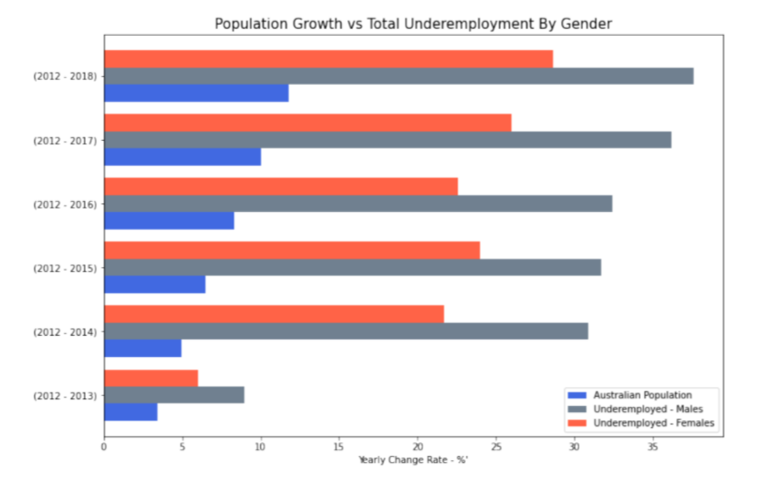
Population Growth
vs
Total Underemployment by Gender

Slide 10

Employment to population ratio and Participation
rate(aged 15-64)

Slide 11
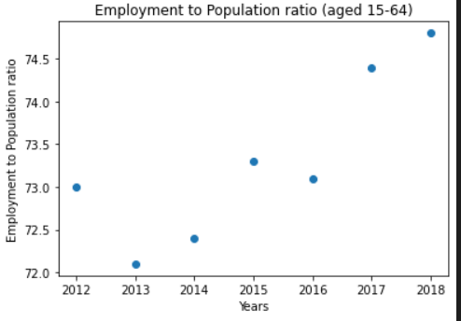
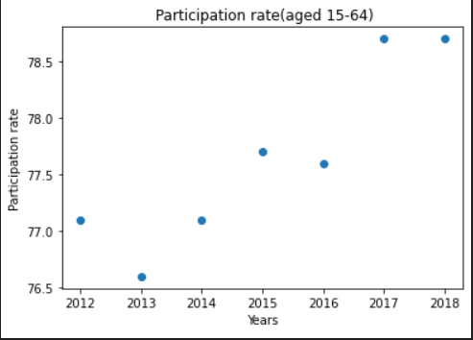
Employment to population ratio (aged 15-64)
Participation rate (aged 15-64)
Employment to population ratio is the proportion of a country's population that is employed.
Workforce participation refers to the share of the working age population who are either in a job or actively looking for one

Slide 12
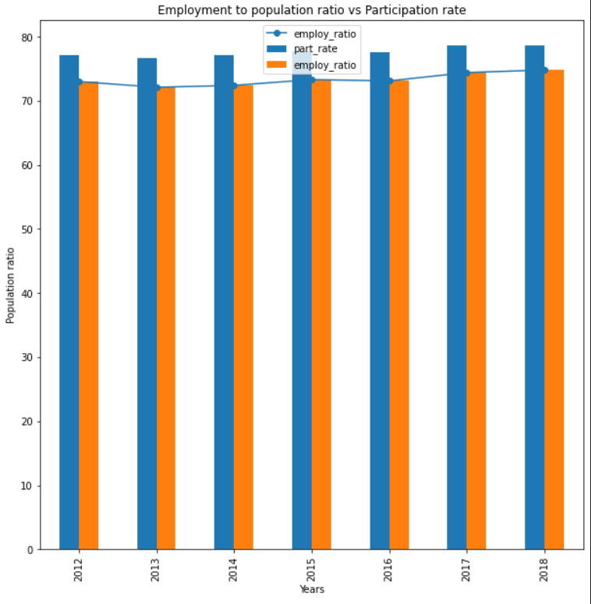
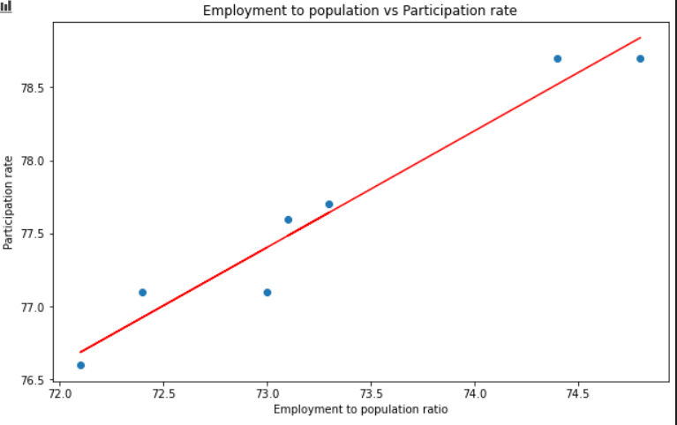
Employment to population ratio vs Participation rate (aged 15-64)
Why is employment to population ratio and participation rate important?
To determine the economic strength of a country
To employ most of the population that helps reduce poverty
Track the pace of job creation
R² = 0.949269
R² = 0.949269

Slide 13

Participation rate /Gender

Slide 14
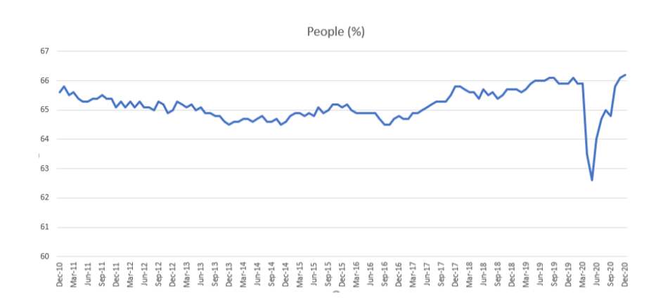
Participation rate, Seasonally adjusted

Slide 15
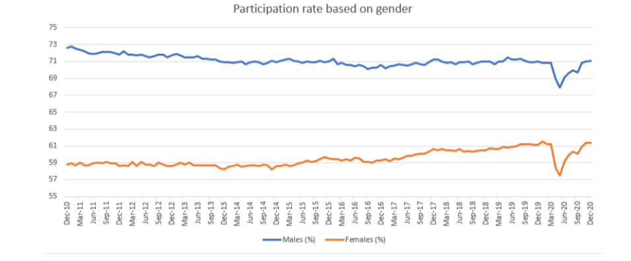
Participation rate based on gender

Slide 16

Changes in Australian Population vs Average total hours worked

Slide 17
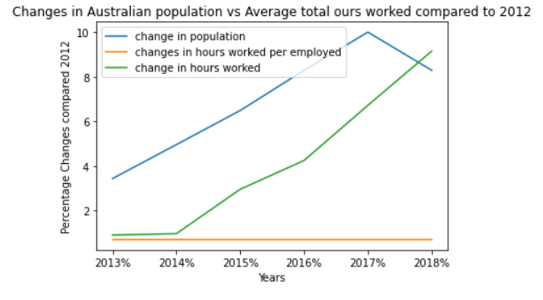
Changes in Australia Population vs Average total hours worked compared to 2012

Slide 18
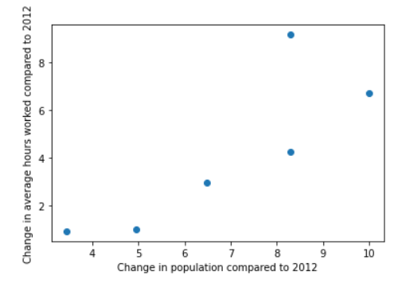
Changes in average hours worked compared to 2012

Slide 19

Conclusions
Employment increases every year in the whole country, the national level at 0.9% max Vic at about 1.4% min SA at 0.04%.
Contrary to any other state, TAS’s average employment change rate 50% higher than its population increase rate.
Over the period of 2012 -2014, the underemployment showed a significant increase over population growth (4.96% and 25.36%) compared with 2012 -2014 (3.44% and 7.17%).
In terms of underemployment over the total industry/occupation listed, agriculture, mining and IT had the highest increase. From 2015 onwards mining had the highest increase overall.
In 2012-2013 the employment status remains the same for both males and females. From 2014-2018 there is a slight increase in the female employment .
The correlation between growth and underemployment, employment to population ratio, participation rate and changes in the annual hours worked all indicate a positive relationship.
The rate of growth in the average annual hours worked trails the rate of change in the population, with exception of 2018 where the growth in average hours worked slightly exceeded the population growth.
The average hours worked per individuals employed was constant for all the years considered

Slide 20



Slide 21


